Slide 1
Brain Stroke Prediction Machine Learning Capstone Project
B.Mounika
Mail Id- monumounika06@gmail.com
Phone no- 8105878144
Batch no - 29

Slide 2
Process flow:
Objective
Understanding the data
Process followed in the project
Illustration of some plots
Result Table
Conclusion

Slide 3
Objective
The objective of a brain stroke prediction ML project is to develop an accurate and reliable model that can predict the likelihood of an individual experiencing a stroke. This model uses machine learning algorithms to analyze a range of input factors, including medical history, lifestyle choices, and physiological data, to identify potential risk factors and early warning signs of stroke. By accurately predicting the likelihood of stroke, this model can help healthcare professionals to intervene early and take proactive measures to reduce the risk of stroke, such as prescribing medication or recommending lifestyle changes. Additionally, this model can be used to raise awareness among the general public about the importance of stroke prevention, leading to better overall health outcomes.

Slide 4
Understanding the Data
Avg_Glucose_Level
Bmi
age
Continuous
Variables
Gender
Heart diease
hypertension
Ever married
Work_type
Residence_type
Smoking_status
Stroke(Target variable)
Categorical

Slide 5
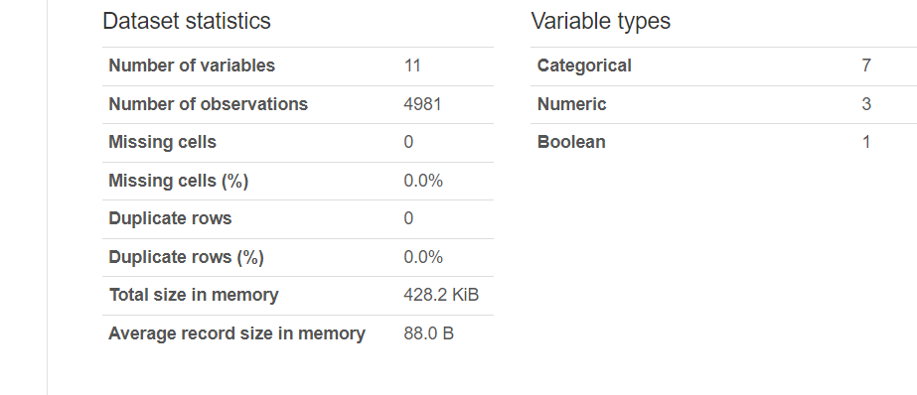
Understanding the Data

Slide 6
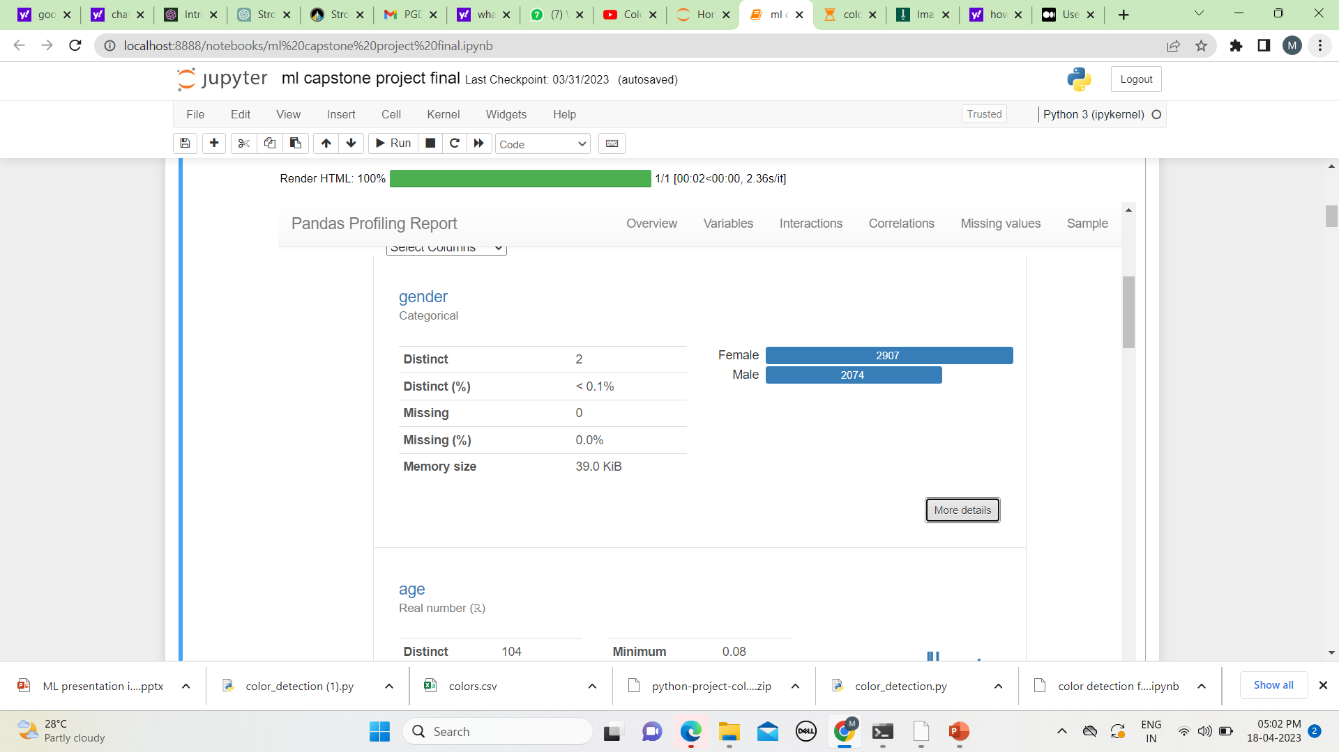
1.Gender
Variable type : Categorical
Gender : (0- Female,1-Male)
Female : 2907
Male : 2074
No null values

Slide 7
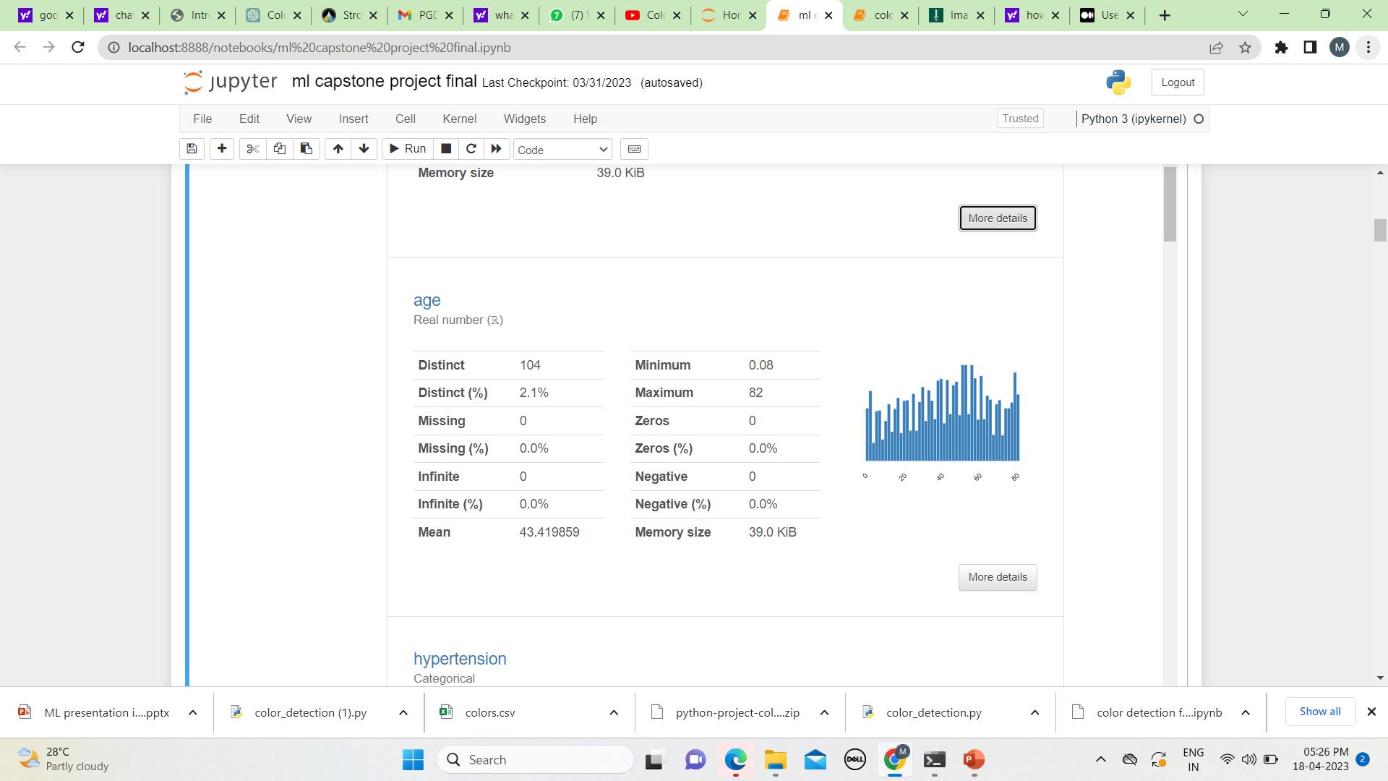
2.Age
Variable type : Continues
Minimum : 0.08
Maximum : 82
Mean : 43.419

Slide 8
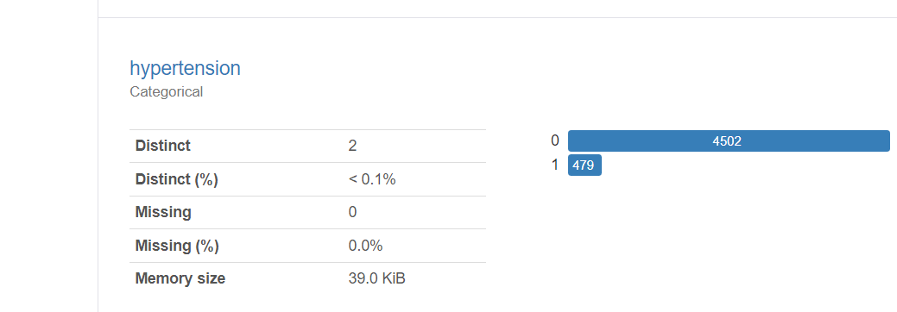
3. hypertension
Variable type :Categorical
Hypertension (0 – no tension , 1 – hypertension)

Slide 9
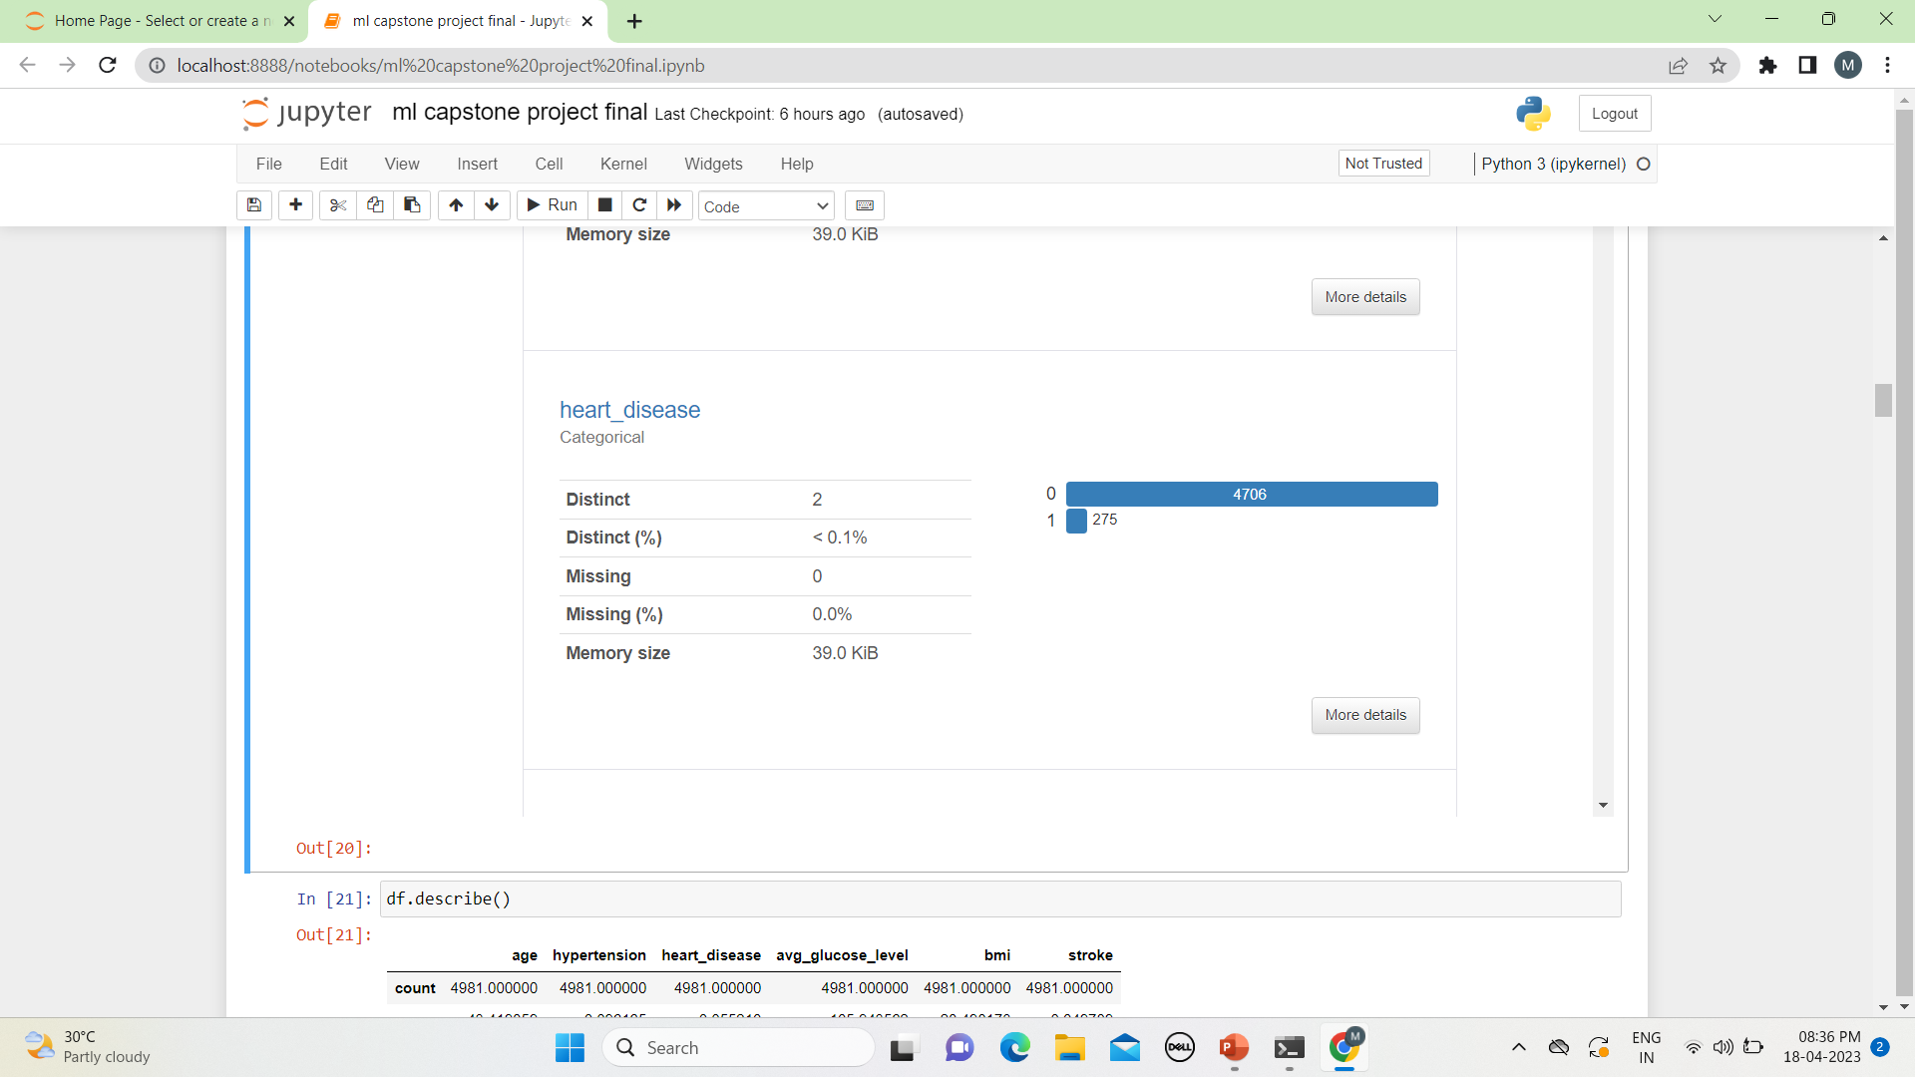
4. Heart disease
Variable type : Categorical
Heart disease : (0-no heart disease, 1- heart disease)

Slide 10
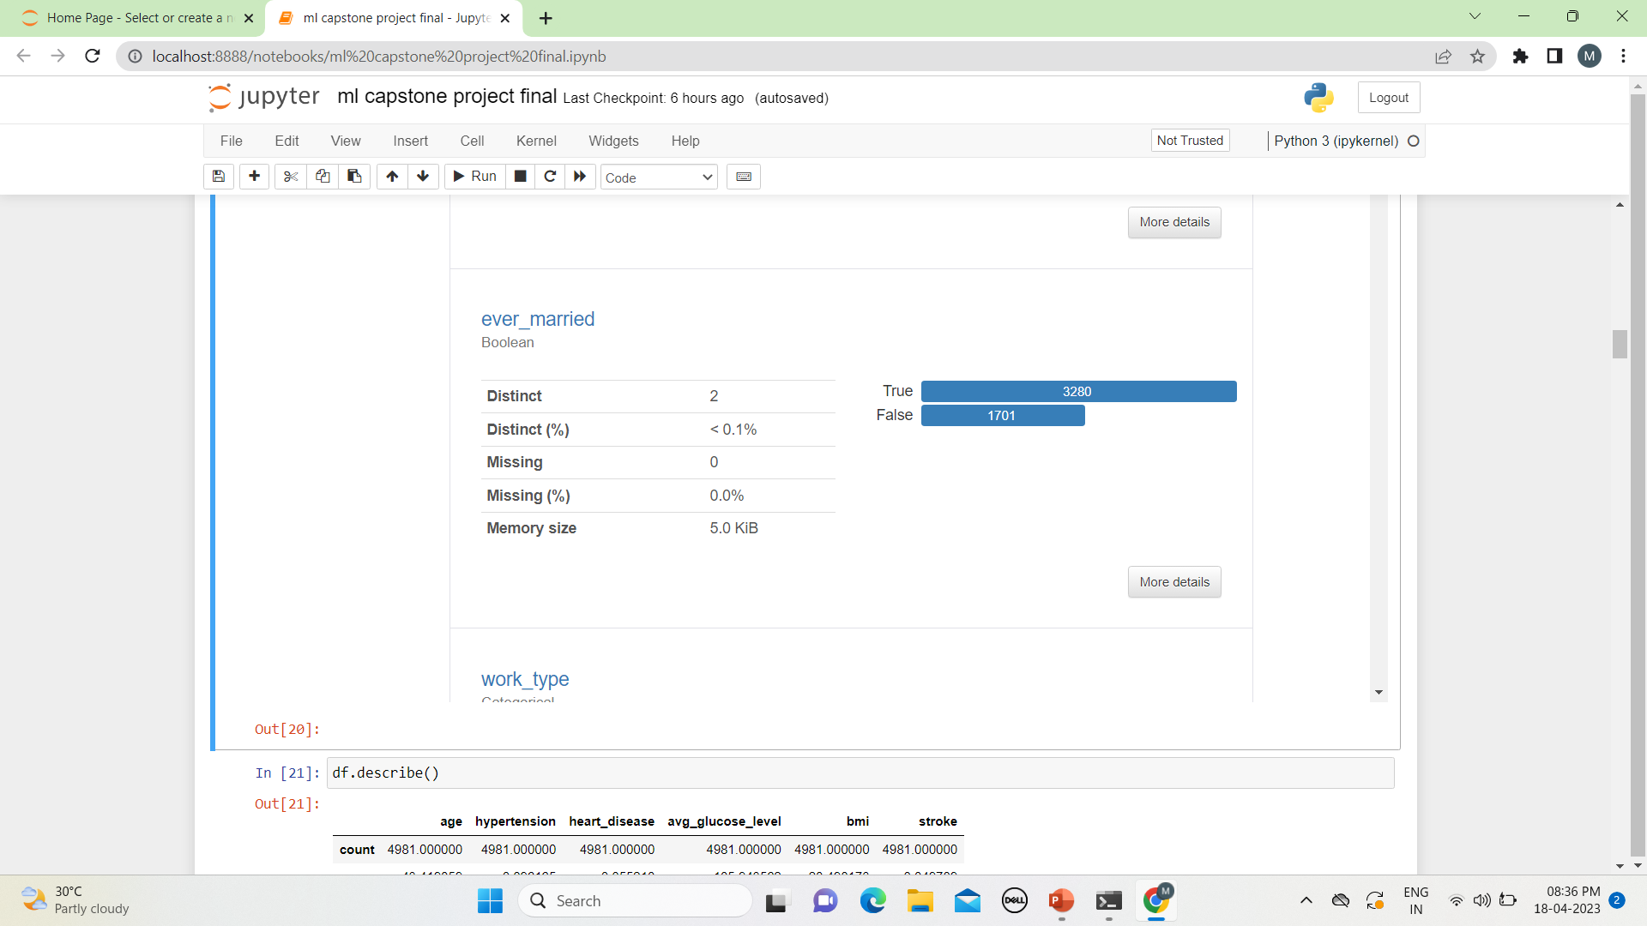
5. Ever_married
Variable type : Boolean
Ever_married : (True – married, False – Non married)

Slide 11
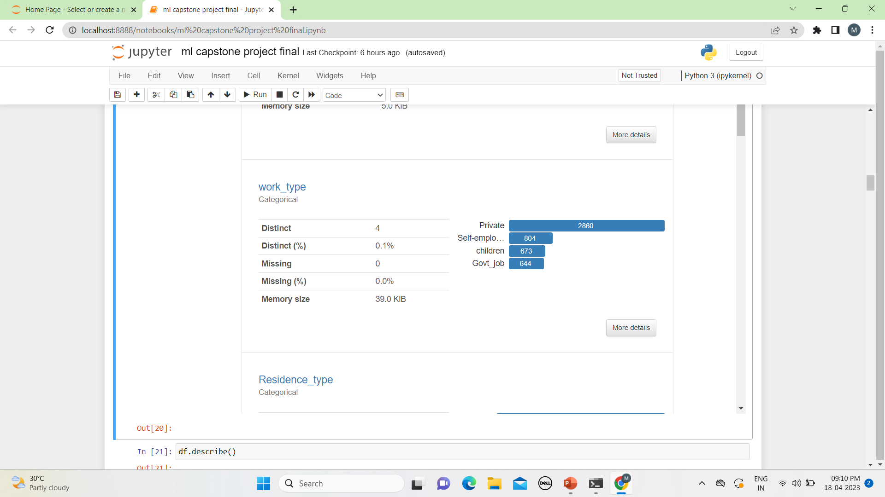
6. work_type:
Variable type : Categorical
Work_type( private – 2860, self – employed – 804, children – 673, govt_job-644)

Slide 12
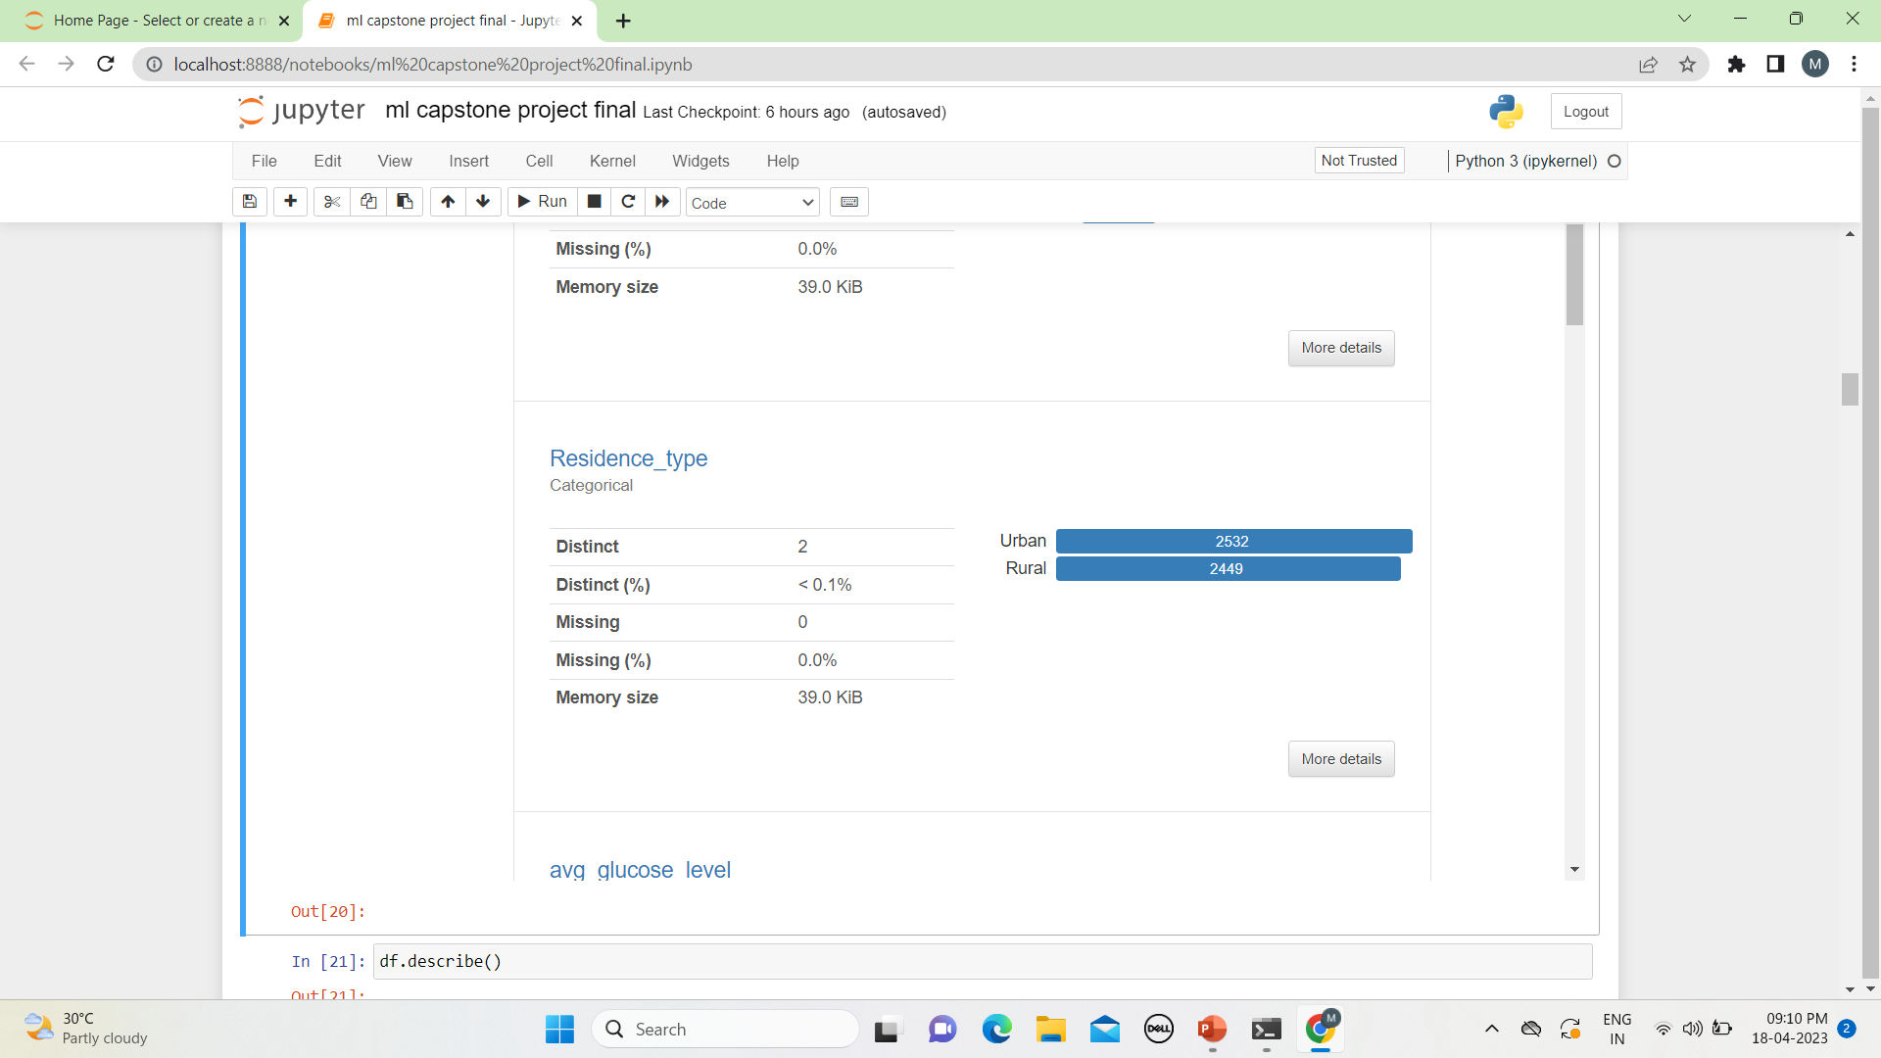
7. Residence_type:
Variable type : Boolean
Residence_type : ( urban - 2532 , Rural - 2449)

Slide 13
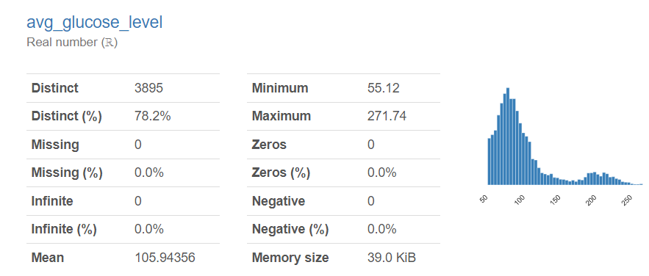
8. Avg_Glucose_Level:
Variable type : Real number
Its varing from 55.12 to 271.74

Slide 14
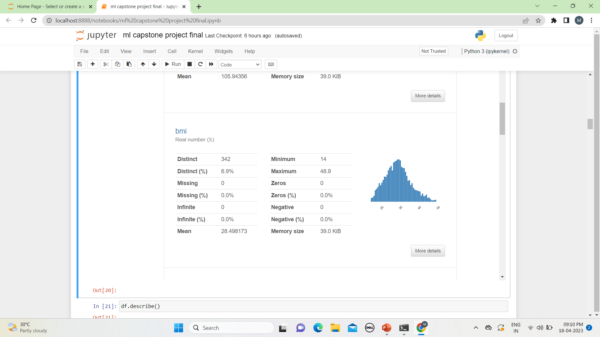
9. BMI:
Variable type : Real number
Its Varing from 14 to 48.9

Slide 15
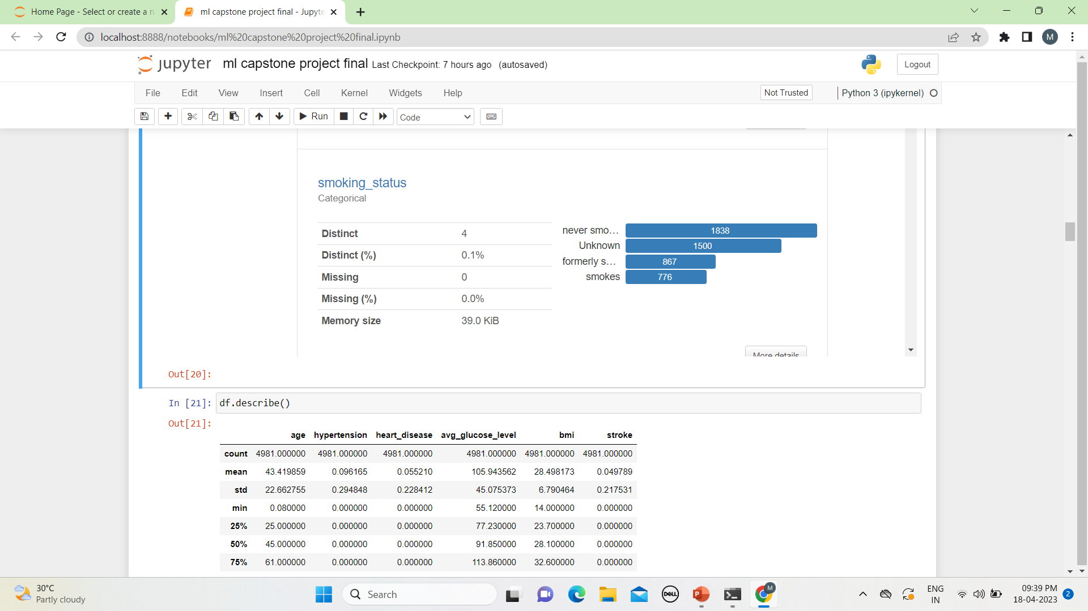
10. Smoking_status
Variable type : Categorical
Smoking_status(0 – never smoked, 1- formerly smokes, 2- Unknown , 3- smokes)

Slide 16
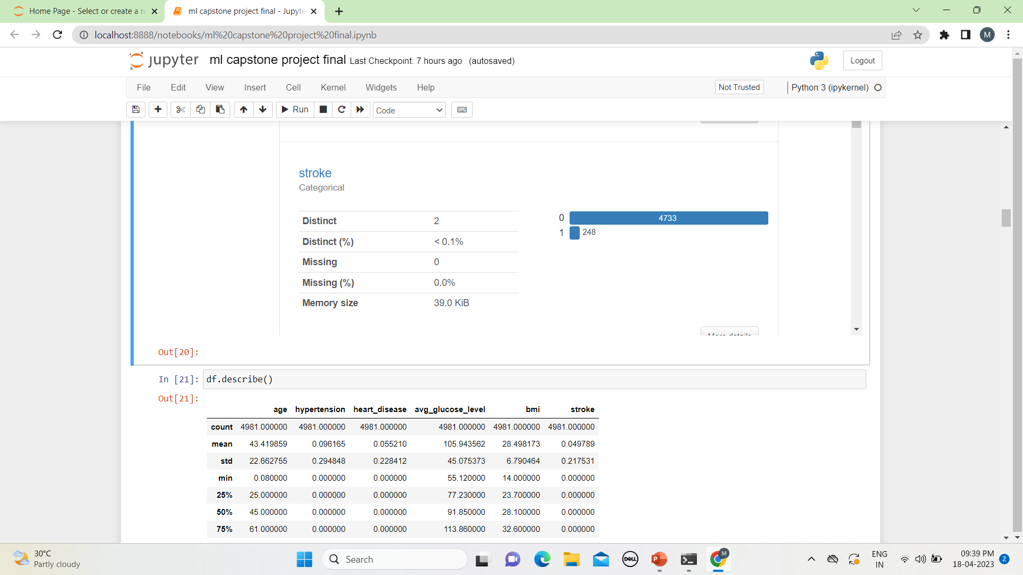
11. stroke:
Variable type : Categorical
Stroke : (0 – 4733, 1 -248)

Slide 17
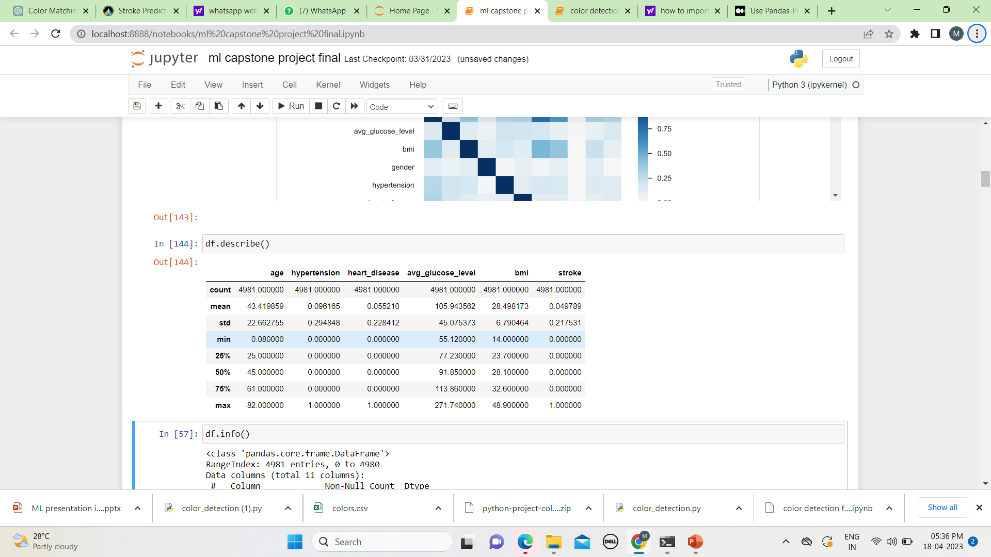
Data information

Slide 18
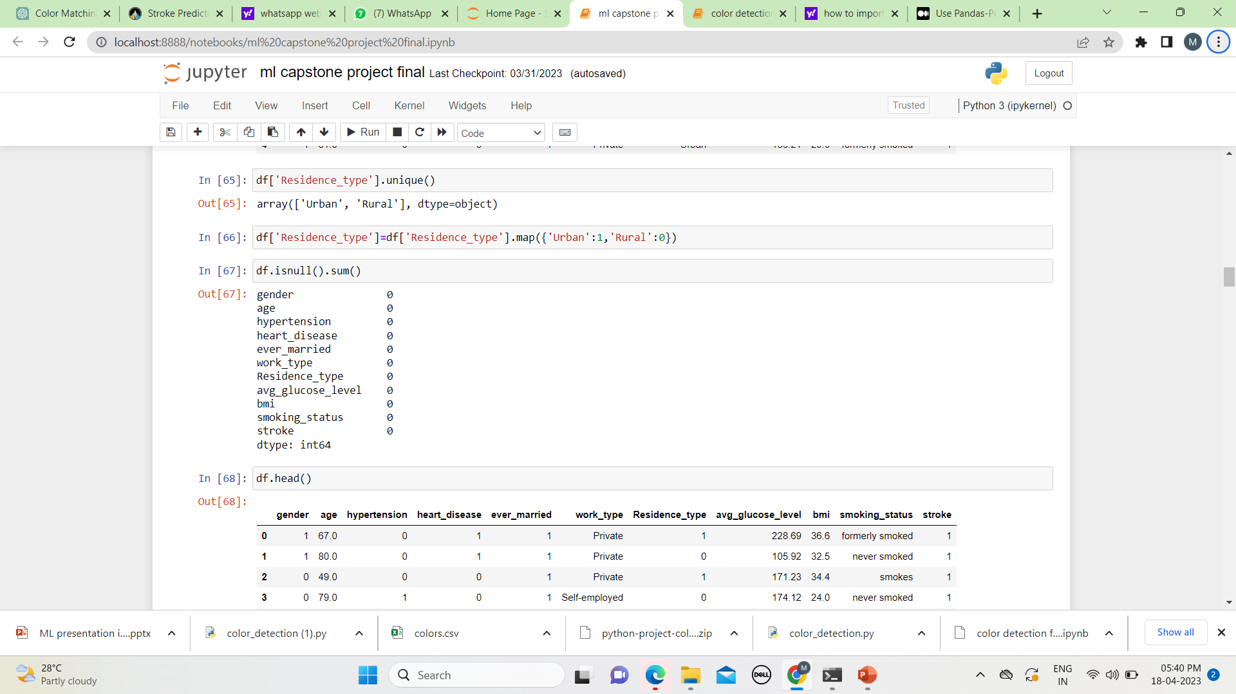
Null values
No null values

Slide 19
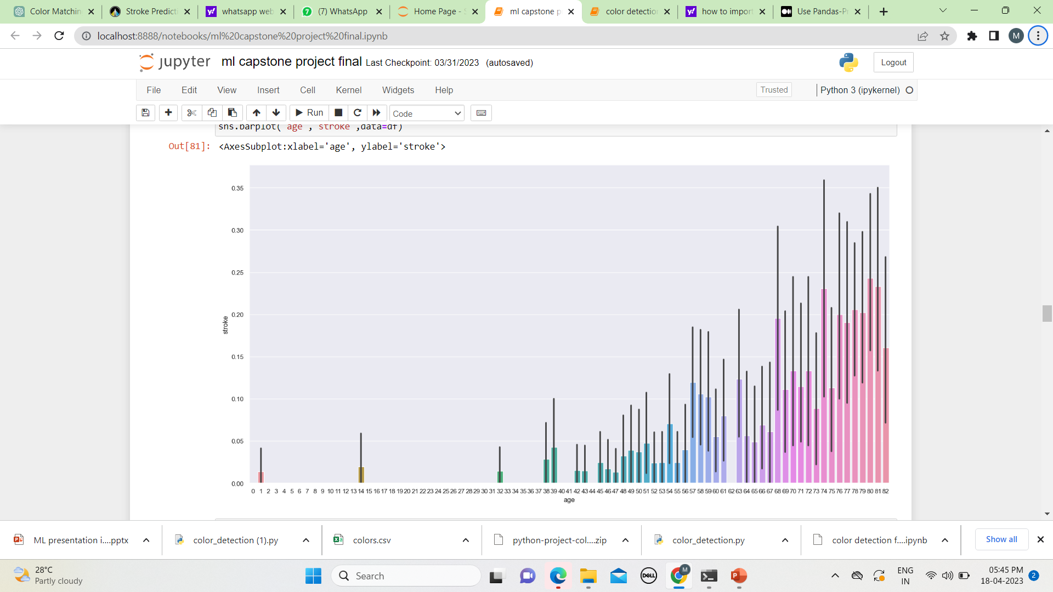
As per the graph as age increases the possibility of stroke increases

Slide 20
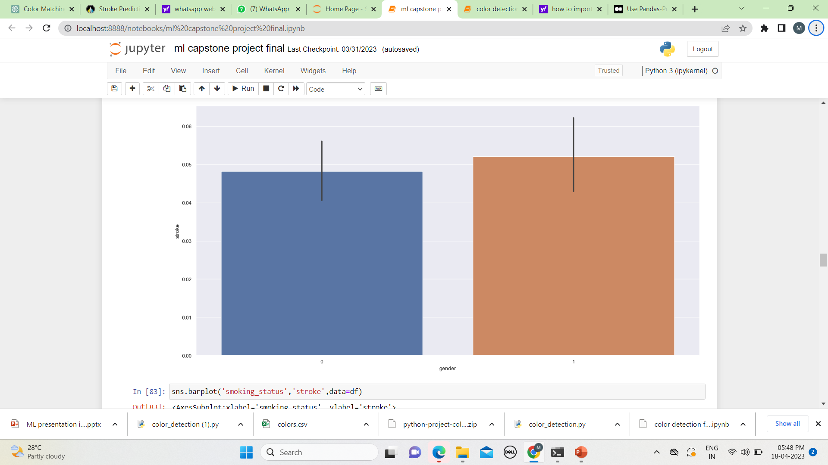
Possibility of getting brain stroke in male and female is almost similar

Slide 21
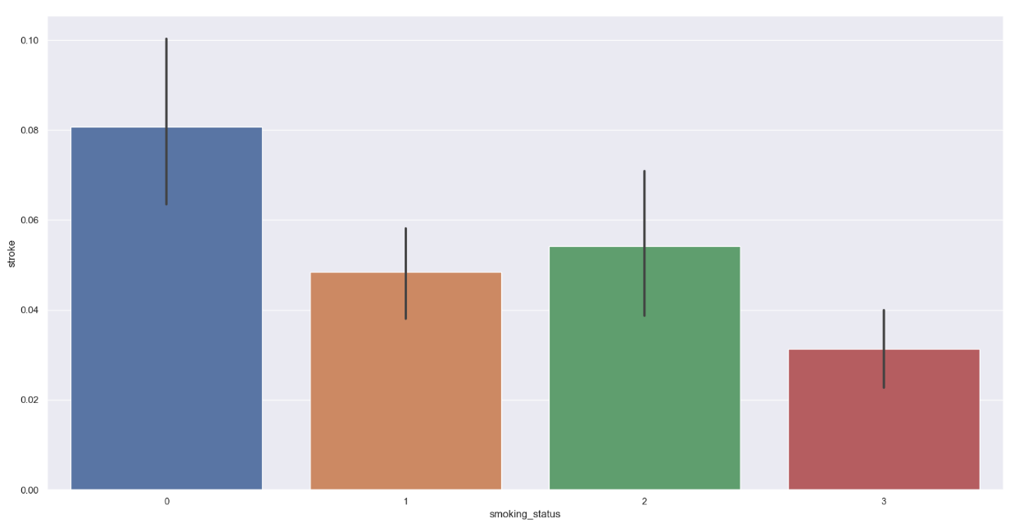
0=never smoked
1= Unknown
2= formerly smoked
3= smoke

Slide 22
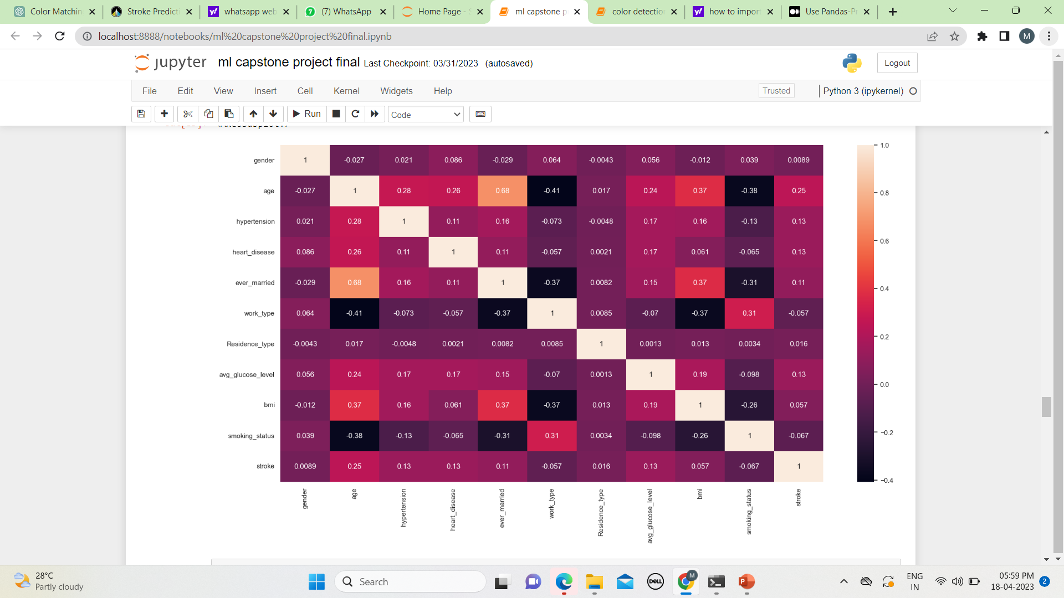
Correlation in between independent variables is less so no multicollinearity

Slide 23
Result Table:
S.No. | Model | Accuracy
1 | Logistic Regression | 0.9526484751203852
2 | KNNeighbors | 0.9446227929373997
3 | Decision Tree | 0.9012841091492777
4 | Random Forest | 0.9468405215646941
5 | Navi bayes | 0.912841091492777
6 | Support vector machine | 0.9526484751203852

Slide 24
Conclusion:

